Slide 1
OceanSITES –
STATUS on NDBP
By
E. Pattabhi Rama Rao
Head-Data and information Management Group
Indian National Centre for Ocean Information Services (INCOIS)
Hyderabad, India

Slide 2
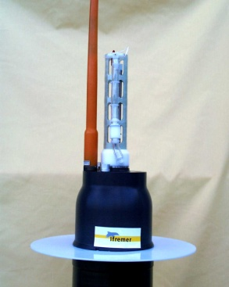
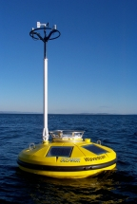

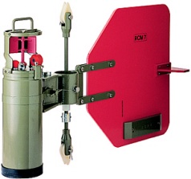
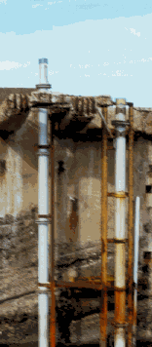
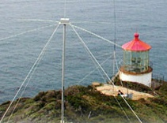
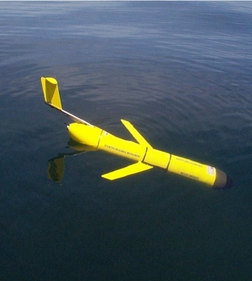
Ocean Observing Systems – In-situ
Argo Floats
Moored Buoys
Drifting Buoys
XBT
Current Meter
Arrays
Research Vessels
INCOIS
NIOT
NIO/INCOIS
NIO/INCOIS
NIO/INCOIS
NIOT/NCAOR/CMLRE
Tide
Gauges
Deep Ocean
Tsunami Buoys
Coastal
Radars
Gliders
SOI/NIOT
NIOT
NIOT
INCOIS

Slide 3
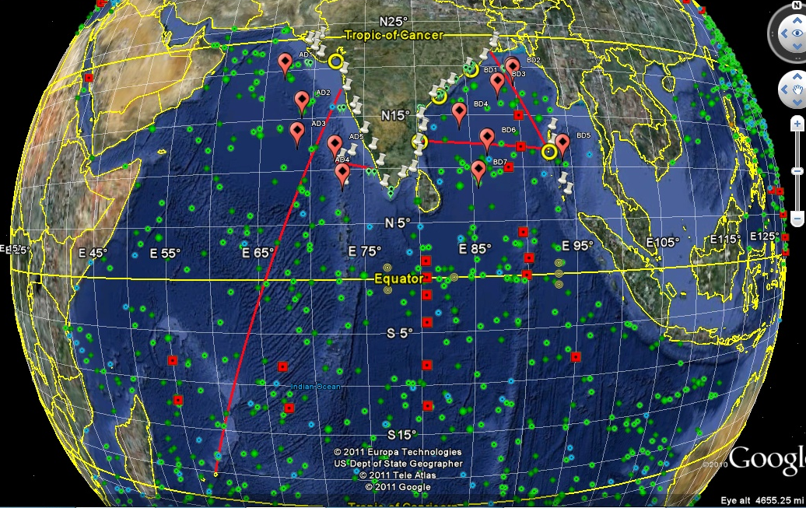
Ocean Observing System - India
Green – Argo, Red line – XBT, Blue – Drifters, red square – RAMA, Yellow- CODAR, green_oval- ADCP, Red_oval – Moorings, white mark - TG

Slide 4

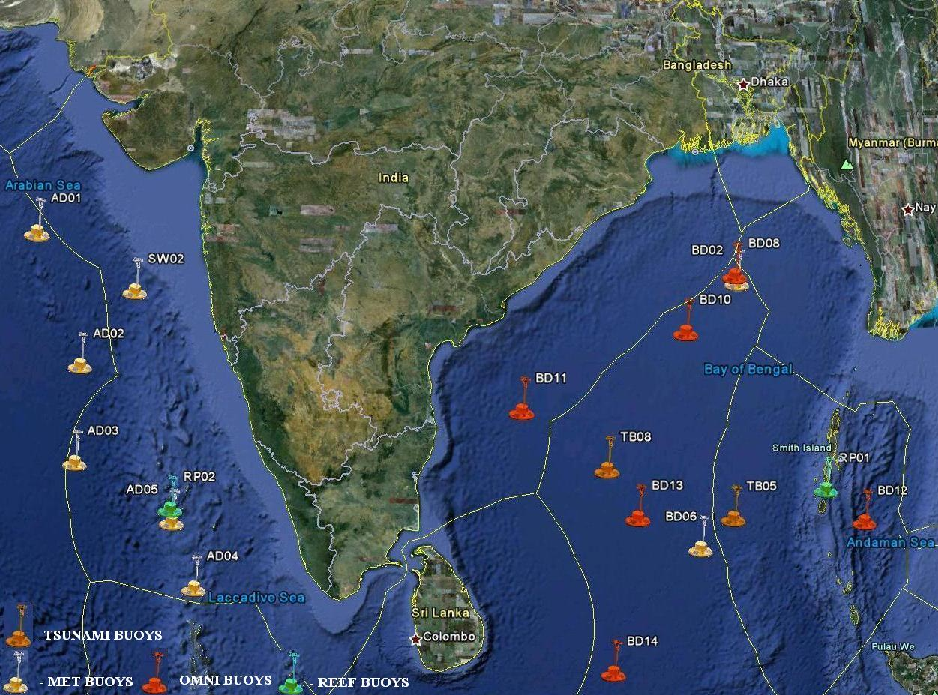
Moored buoys
15 Met Ocean and 6 Tsunami buoys
Notes:
W eather forecasts. Meteorological models routinely assimilate observational data, from various sources including data buoys. This is major acehiveemnt on Indian time series measurement on real time data collelction which is a collecive effort of Ministry NIOT INCOIS NCAOR IMD. As secretary syas mainatnece is important that’s what we have been doing by executing very tough field operations more than 80 such activities at sea in 22 cruises
we are also in the process fio dvdeloping next GEN buoy system

Slide 5
Progress (September 2010- September 2011)
OOS has carried 85 operations, 22 cruises involving 395 ship days, 4192 man days,
~ 19,000 nm of sailing distance in Bay of Bengal, Arabian Sea and Indian Ocean
Presently 12 deep sea buoys (6 OMNI + 6 Met Ocean)
+ 2 Coastal Buoys +1 CALVAL
Total Functional Buoys : 15

Slide 6
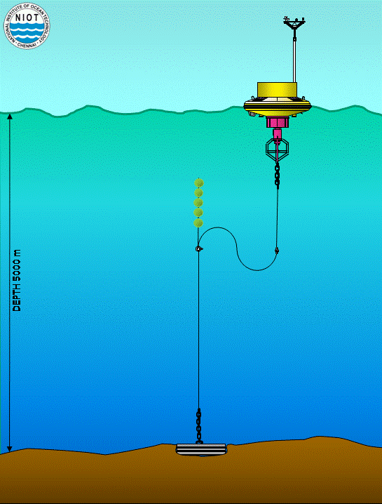
Moored Buoy Network
Surface meteorological
  Wind speed and direction
  Air temperature
  Air pressure
  Humidity
  Short wave radiation
  Incoming long wave radiation
  Precipitation
surface Ocean parameters
  Sea surface temperature
  Conductivity
  Wave
  Current speed and direction
Sub surface parameters
  Temperature and salinity at depths starting from 5m, 10m, 15m, 20m 30m, 50 m, 75 m, 100 m, 200m and 500m
  Currents at depth levels 10m, 20m, 30m, 50m and 100m

Slide 7
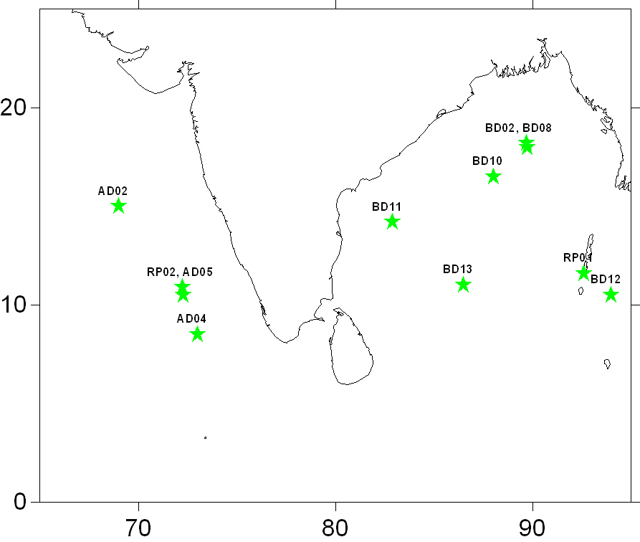
Active moored buoys as on 26 Nov 2011

Slide 8
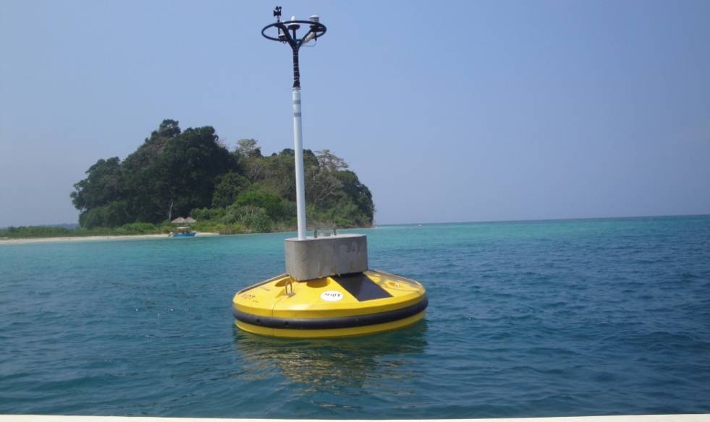
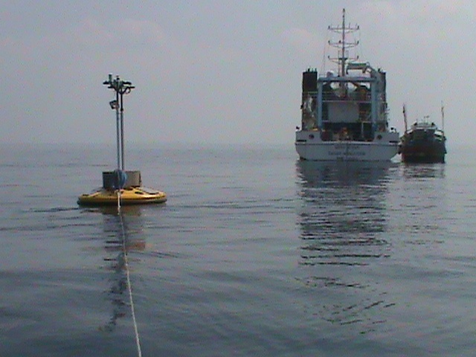
CORAL REEF BUOY
ANDAMAN & LAKSHADWEEP
Buoy Features
Measures : Wind Speed & Direction
Air Temperature
Air Pressure and Humidity
Underwater: Dissolved Oxygen,
Turbidity, Salinity, pH, Conductivity, SST,
        Current Speed & Direction
        Coral Reef Environment Friendly Anchor

Slide 9
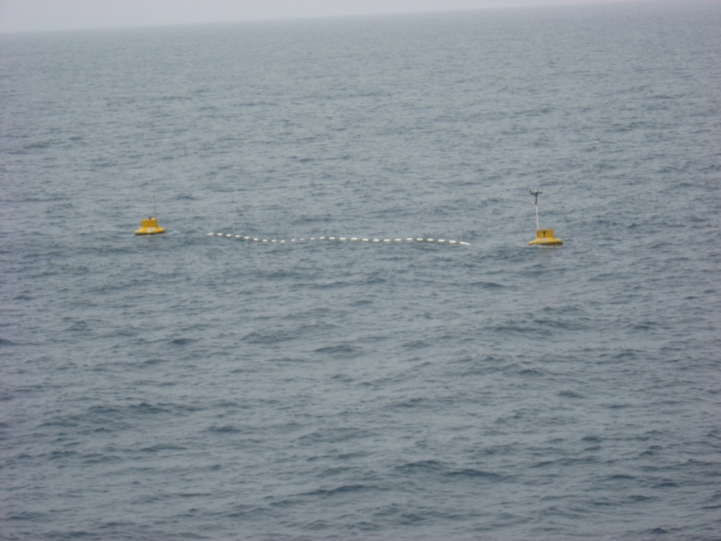
Satellite data
Calibration Validation site
Jointly with SAC -ISRO
India has launched largest remote sensing Satellites
Optical sensors
Optical buoy attached Met ocean buoy
DIRECTIONAL
WAVERIDER
DATA BUOY
DIRECTIONAL
WAVERIDER
Arabian sea
Kavaratti SIte for CAL / VAL

Slide 10
Best of Practice
Work flow chart
Deployment
Retrieval
Design / End user requirement
Buoy Retrieval
Ordering and Procurement
Checking, Trial test and accepting the component
Physical check of Buoy components for damages
Stores entry
Failure Analysis
Interfacing / Configuring for buoy CPU
Dismantling and Cleaning of sensors / Instruments
Testing all the Sensors/ Instruments with Buoy CPU for 5 days
Confirmation / Checking of TX data quality
Component testing
Re-calibration and refurbishing of retrieved buoy Components.
YES / NO
Updating stores record
Integrated testing for 10 days 3 hourly iNMARSAT
C
A
B
YES / NO
C
Dismantling and Packing of buoy components for transport
Hand over the tested buoy to Deployment team with OOS Stores entry
On board integrated testing for 2 days
Deployment and confirmation of two consecutive data sets (6 hours)

Slide 11
Data Dashboard
Buoy stopped due to act of vandalism
SL.NO | Buoy ID | 2010 |  |  |  |  |  | 2011 |  |  |  |  |  |  |  |  | Data Sets
 |  | JUL | AUG | SEP | OCT | NOV | DEC | JAN | FEB | MAR | APR | MAY | JUN | JUL | AUG | SEP
1 | AD1 |  |  |  |  |  | 121/121 | 248/248 | 224/224 | 232/248 | 239/240 | 248/248 | 240/240 | 248/248 | 248/248 | 151/152 | 2199
2 | AD2 |  |  |  |  |  | 110/110 | 244/248 | 218/224 | 242/248 | 237/240 | 242/248 | 238/240 | 245/248 | 244/248 | 148/152 | 2168
3 | AD3 |  |  | 88/88 |  |  | 20/20 | 246/248 | 222/224 | 248/248 | 240/240 | 248/248 | 240/240 | 248/248 | 248/248 | 151/152 | 2199
4 | AD4 |  |  |  |  |  |  | 238/239 | 224/224 | 248/248 | 240/240 | 248/248 | 239/240 | 248/248 | 247/248 | 151/152 | 2083
5 | AD5 |  |  |  |  |  | 7/7 | 150/248 | 122/224 | 200/248 | 62/240 | 125/248 | 217/240 | 230/248 | 231/248 | 142/152 | 1479
6 | BD1 |  |  |  |  | 182/182 | 247/248 | 248/248 | 223/224 | 248/248 | 240/240 | 209/209 |  |  |  |  | 1597
7 | BD2 |  |  |  |  | 174/174 | 247/248 | 248/248 | 224/224 | 248/248 | 240/240 | 248/248 | 233/240 | 206/248 | 118/123 (121/126) | 139/152 | 2446
8 | BD3 |  |  |  |  | 156/156 | 248/248 | 248/248 | 224/224 | 90/90 |  |  |  |  |  |  | 966
9 | BD4 |  |  |  |  | 70/70 | 247/248 | 248/248 | 224/224 | 202/202 |  |  |  |  |  |  | 991
10 | BD6 | 159/160 | 244/248 | 240/240 | 247/248 | 240/240 | 247/248 | 248/248 | 227/224 | 248/248 | 236/240 | 246/248 | 238/240 | 27/24 | 5/5 | 83/83 | 2930
11 | SW2 |  |  |  |  |  |  |  |  | 60/60 | 239/240 | 248/248 | 240/240 | 248/248 | 247/248 | 152/152 | 1434
12 | RP1 |  |  |  |  |  |  |  | 46/46 | 248/248 | 240/240 | 248/248 | 239/240 | 248/248 | 248/248 | 152/152 | 1669
13 | RP2 |  |  |  |  |  |  |  |  | 278/278 | 720/720 | 744/744 | 720/720 | 743/744 | 744/744 | 455/456 | 4404
14 | BD13 |  |  |  | 129/129 | 365/365 (40/40) | 744/744 | 744/744 | 613/613 |  |  |  | 614/614 | 744/744 | 231/232 (474/474) | 456/456 | 5154
15 | BD14 |  |  |  | 140/140 | 576/578 | 709/711 | 742/744 | 669/672 | 744/744 | 720/720 | 744/744 | 699/720 | 744/744 | 744/744 | 130/130 | 7361
16 | BD08 |  |  |  |  |  |  |  |  |  |  | 64/65 | 720/720 | 743/744 | 345/345 (373/373) | 456/456 | 2701
17 | BD10 |  |  |  |  |  |  |  |  |  |  | 83/83 | 720/720 | 744/744 | 417/417 (283/283) | 456/456 | 2703
18 | BD11 |  |  |  |  |  |  |  |  |  |  |  | 665/666 | 744/744 | 744/744 | 456/456 | 2609
19 | BD12 |  |  |  |  |  |  |  |  |  |  | 114/114 | 719/720 | 744/744 | 743/744 | 456/456 | 2776
TOTAL |  |  |  |  |  |  |  |  |  |  |  |  |  |  |  |  | 49869

Slide 12
Parameters available from active buoys
Buoy_ID | Lat (°N) | Lon(°E) | Parameters
AD02 | 14.999 | 69.004 | AirTemp, AirPres, Hum, Cond, Temp, Winds
AD04 | 08.511 | 73.009
AD05 | 10.500 | 72.267
BD02 | 17.968 | 89.719 | AirTemp, AirPres, Hum, Cond, Temp, Winds, Currents
RP01 | 11.593 | 92.604 | AirTemp, AirPres, Hum, Cond, Temp, Winds, pH, Turbidity
RP02 | 10.880 | 72.220 | AirTemp, AirPres, Hum, Cond, Temp, Winds, pH, Waves
BD10 | 10.499 | 93.998 | AirTemp, AirPres, Hum, Cond, Temp, Winds, Currents
BD12 | 11.007 | 86.486
BD13 | 16.500 | 88.002
BD08 | 14.203 | 82.903 | AirTemp, AirPres, Hum, Cond, Temp, Winds, Currents, Waves
BD11 | 18.191 | 89.675
Subsurface Parameters
Buoy_ID | Parameter | Measurement Depth Levels (m)
BD08, BD10,BD11, BD12, BD13 | Temp | 5,10,15,20,30,50,75,100,200,500
 | Salinity
 | Currents | 1.2,10,20,30,50,100

Slide 13
Status of Moored Buoys data supply to OceanSITES
As per the OCEANSITES mandate, INCOIS has so far submitted surface data in netCDF (C.F. 1.1 Format) of NINE met-ocean buoys namely:
Buoy ID | WMO ID | Lat | Lon | Data provided
NIOT CVAL | 23102 | 13.180 | 80.390 | Aug 2006 to Jan 2009
NIOT MB04 | 23451 | 20.880 | 71.490
NIOT MB09 | 23456 | 16.990 | 71.100
NIOT MB20 | 23491 | 15.010 | 73.020
NIOT MB23 | 23170 | 12.940 | 74.720
NIOT MB24 | 23098 | 8.700 | 78.230
NIOT MB26 | 23494 | 12.140 | 90.770
NIOT OB10 | 23101 | 15.500 | 69.280
NIOT OB12 | 23455 | 10.650 | 72.510

Slide 14
List of parameters transmitted through GTS
All the surface met-ocean parameters like:
1. Air Pressure
2. Atmospheric Temperature
3. Humidity
4. Winds
5. SST
6. Salinity

Slide 15
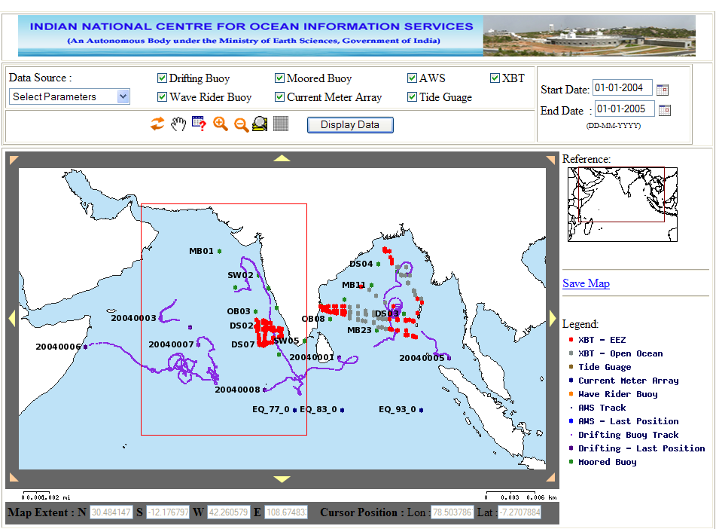
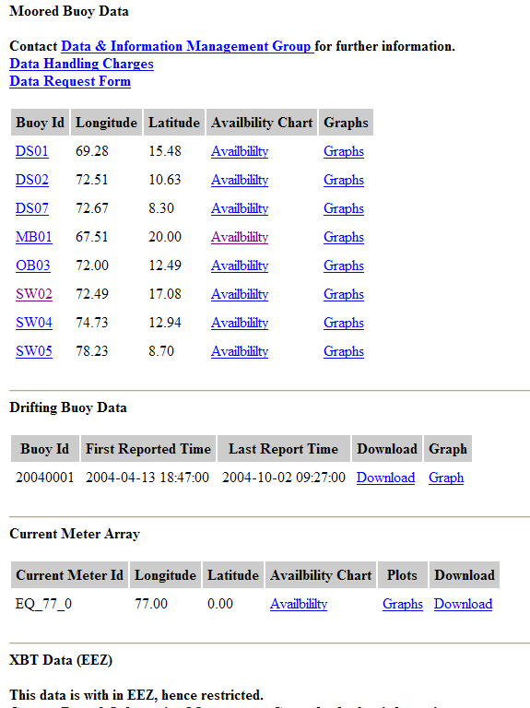
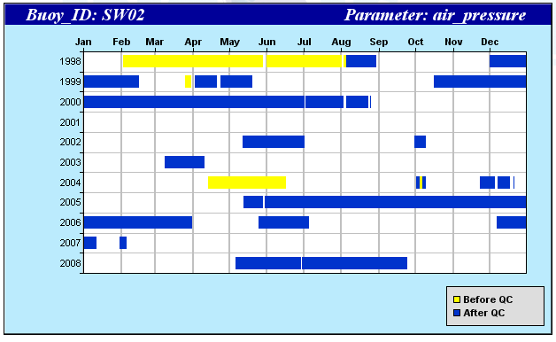
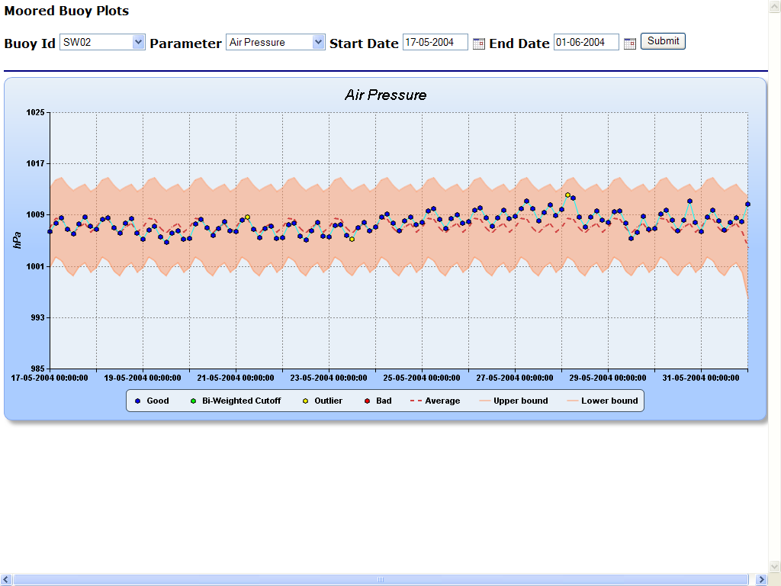
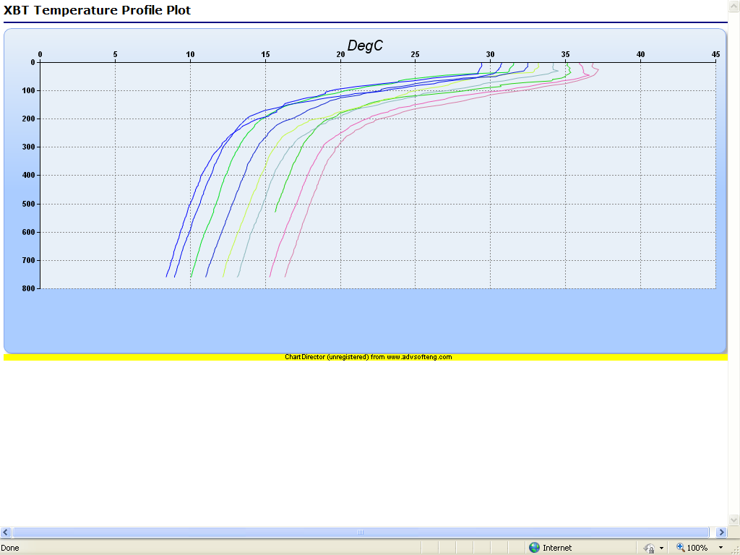
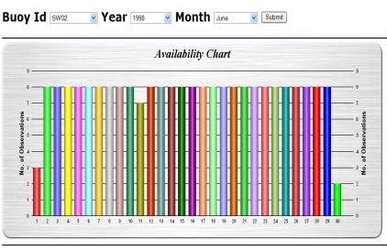
Ocean Data and Information System (ODIS)
Fully automated system for data reception, processing, quality control, database loading and dissemination
Unique integrated in-situ database for heterogeneous data received from variety of platforms through various communication channels
Data discovery, on-the-fly visualization and data downloads in different formats
Developed in-house using Open Source Software
Query Template
Data Availability
Charts and Statistics
Time Series Graphs
Profiles

Slide 16
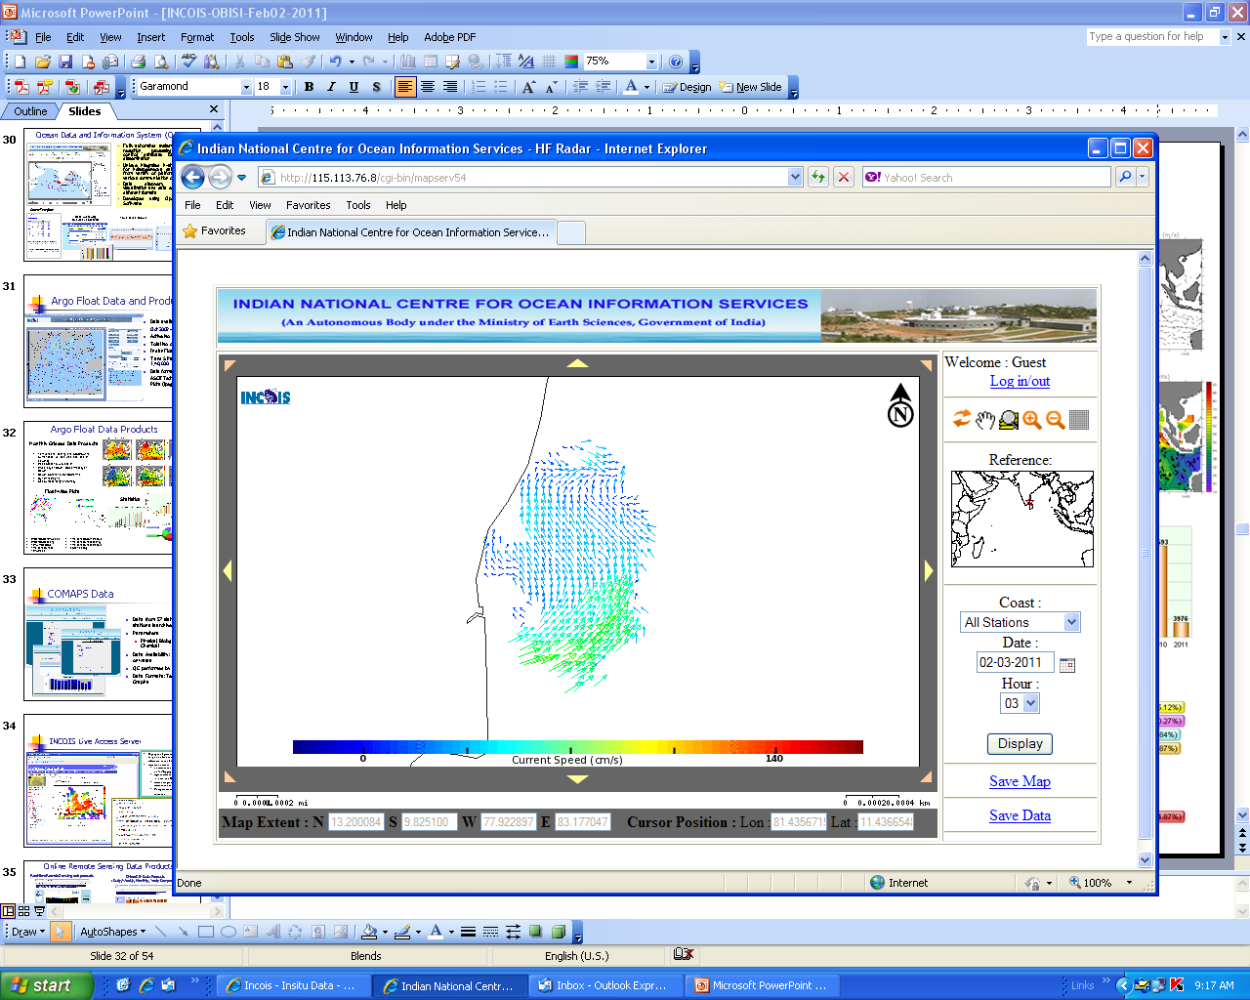
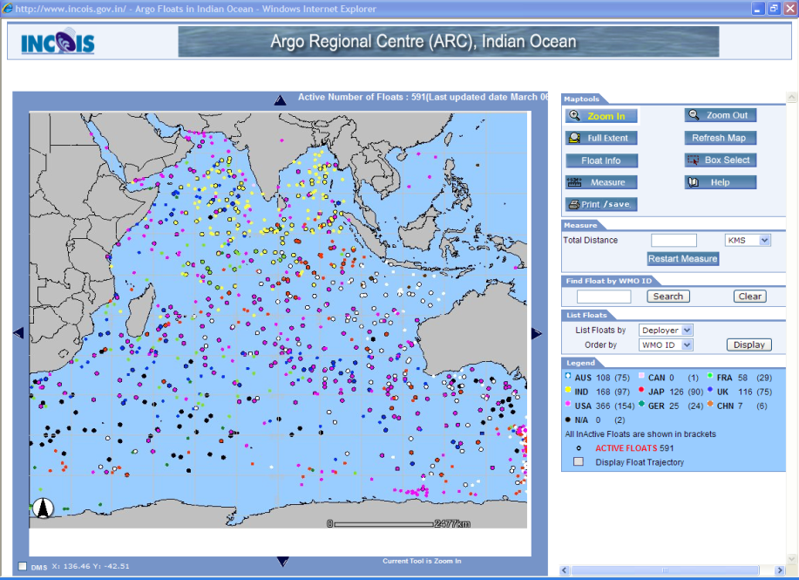
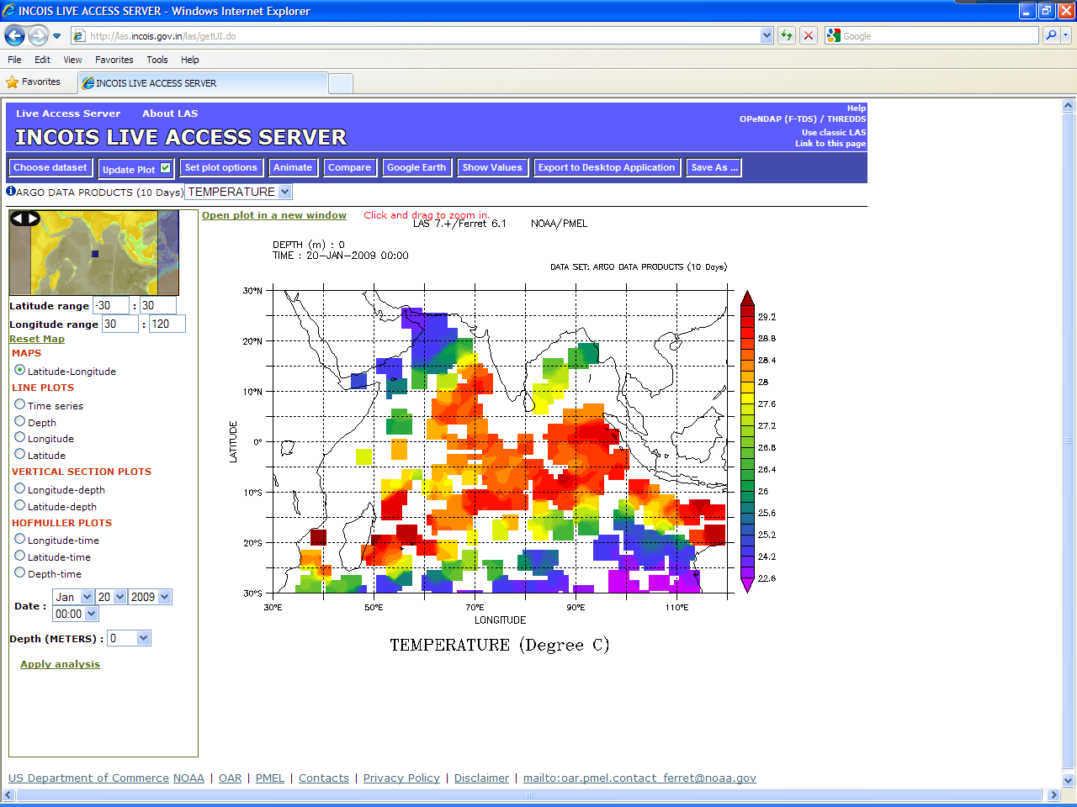
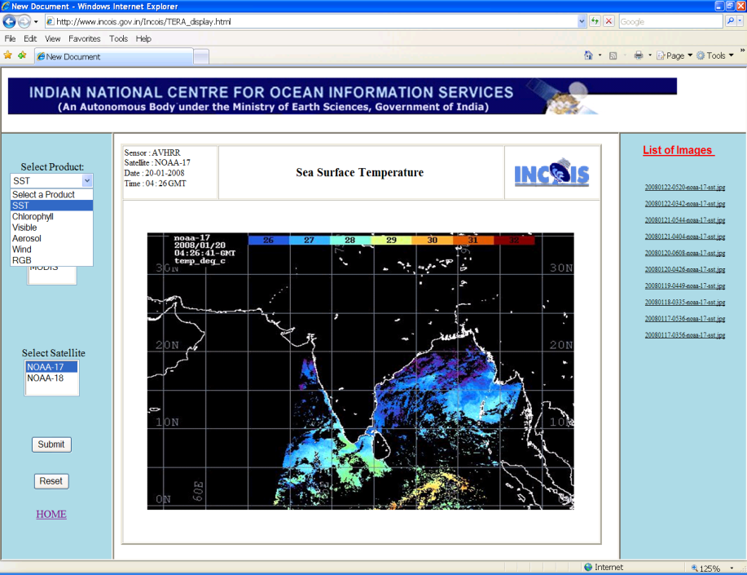
Online Data and Products
HF Radar Data
In-situ Data Products
INCOIS Live Access Server
Remote Sensing Data Products

Slide 17
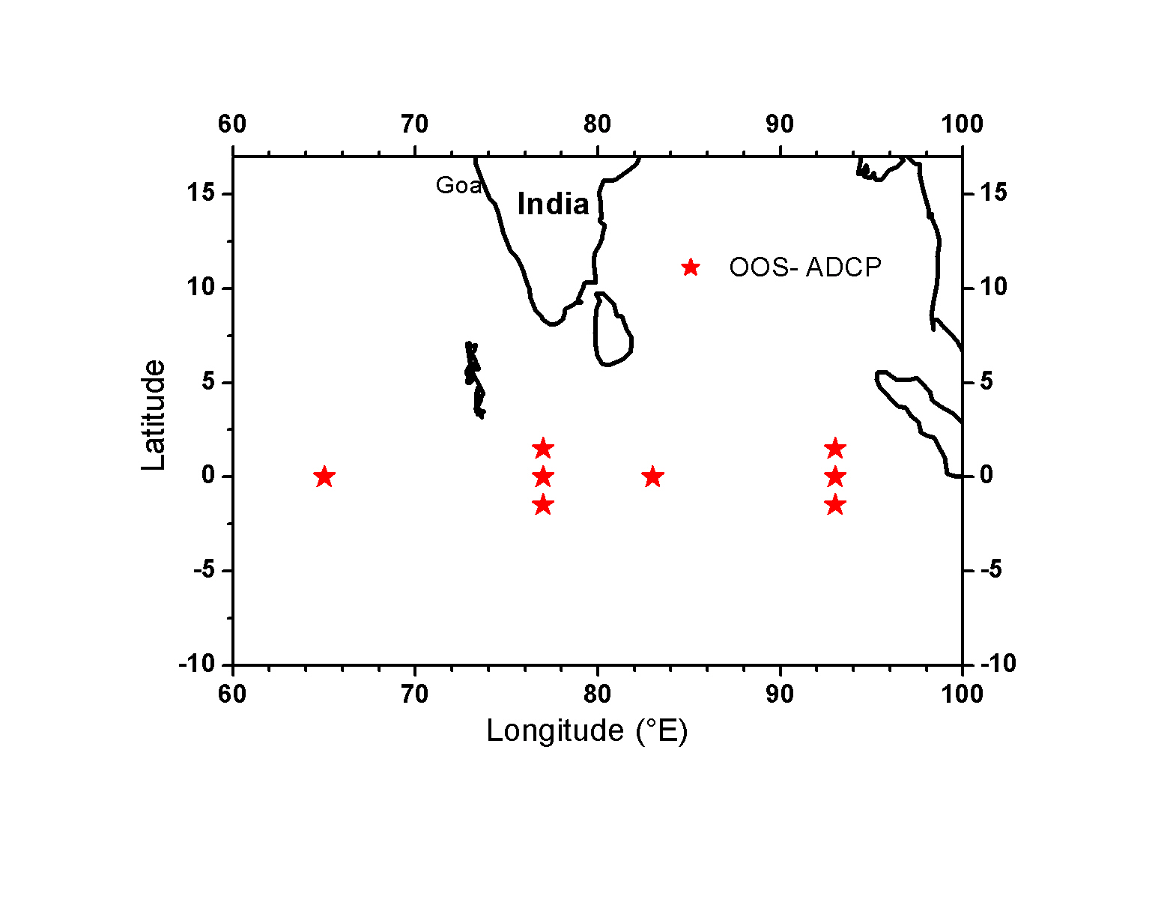
Equatorial Current meter mooring
OOS – moorings in the equatorial Indian Ocean
4- Additional ADCP moorings at 1.5N and 1.5S
at 77E and 93E are proposed during XI plan.
All moorings will now have 75 kHz ADCPs.
NIO through INCOIS/MoES

Slide 18
Present Status of Current meter data
Four sub surface current meter mooring data had been uploaded to Oceansites portal.
Buoy ID | Lat (°N) | Lon(°E) | Data provided to OceanSITES
CM-EQCM3A-77E | 0.000 | 77.000 | Feb 2000 to Jan 2006
CM-EQCM2-83E | 0.000 | 83.000
CM-EQCM1-93E | 0.000 | 93.000
CM-EQCM3-76E | 0.000 | 76.000
** Presently Current meter data is available up to November 2009

Slide 19
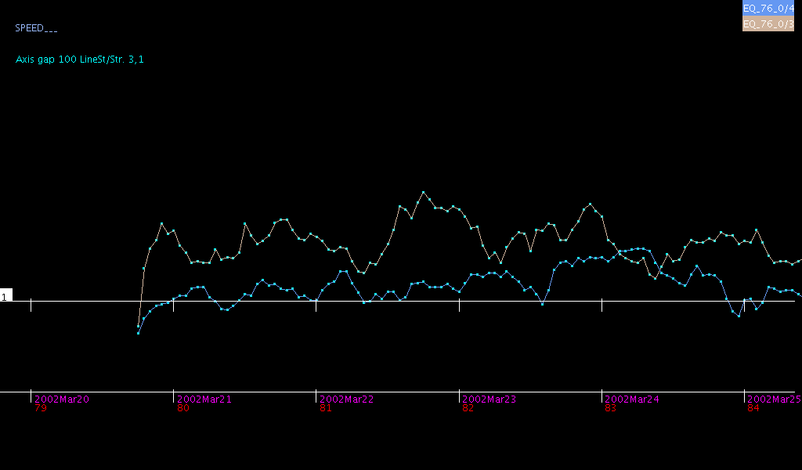
Current Meter data and QC
Quality Control of Current Meter data was tested with EDSERPLO package provided by BODC UK.
It was modified to suit the INCOIS data base schemas and now synchronization with data base is in progress

Slide 20
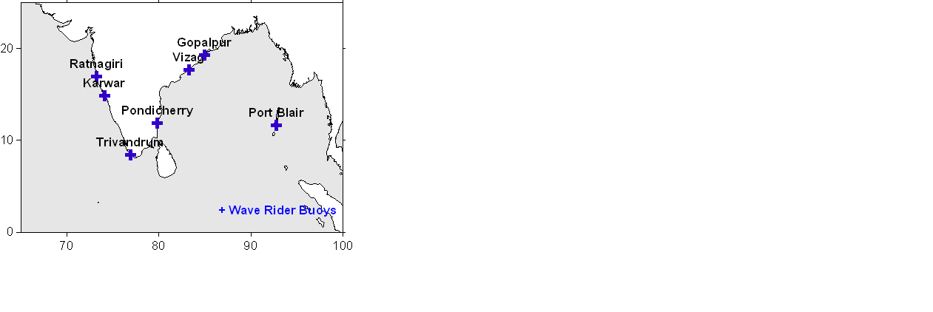
Wave Rider Buoys

Slide 21
Wave Rider Buoy Parameters
Symbol | Parameter Name
Date/Time | Observation Time
To | Peak (Modal) Period
Dirp | Peak Direction
Sprp | Peak Directional Spread
Tz | Zero-upcross Period
Hm0 | Significant Wave Height
TI | Integral Period
T1 | Wave Mean Period
Tc | Crest Period
Tdw2 | sqrt(m[-1] / m1)
Tdw1 | sqrt(m[-1,2] / m0)
Tpc | calculated peak period
Nu | band width parameter
Eps | bandwidth parameter
QP | Goda's peakedness parameter
Ss | significant steepness
TRef | reference temperature
TSea | sea surface temperature
Bat | Battery Voltage

Slide 22
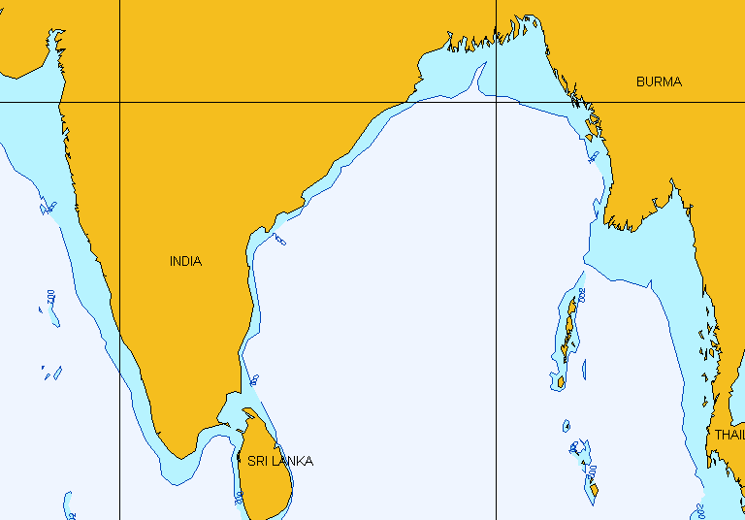
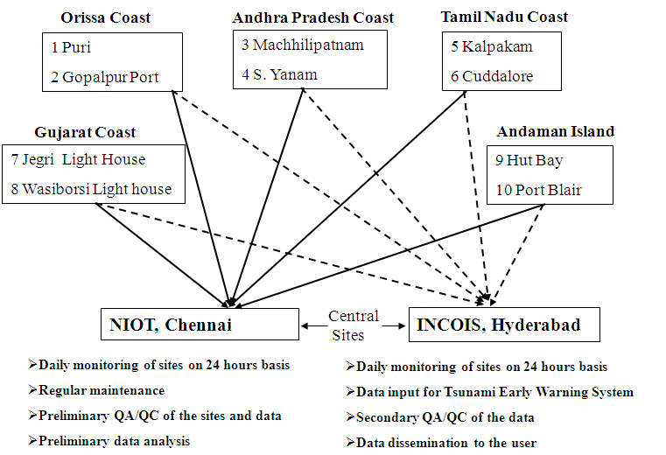
HF Radar Network
Phase I ( completed by March 2008)
  Cudallore
  Kalpakkam
  Machilipatnam
  Yanam
Phase II (completed by September 2009)
  Jegri
  Wasi
  Gopalpur
  Puri
Phase III (completed by May 2010)
  Port-Blair
  Hut-Bay

Slide 23
XII Plan (2012-17) Proposal - Observations
S. No. | Observing System | Existing during XI Plan | Proposed during XII Plan | Nodal/Implementing Institute | Other Partners
1. | Met-ocean data buoys attached with surface and sub-surface sensors in the open ocean. | 12 | 12 | NIOT | INCOIS
2. | Met-ocean data buoys attached with sensors for the measurement of surface parameters in the coastal region | 0 | 04 | NIOT | INCOIS
3. | Argo profiling floats (3 X 3 deg spatial resolution) | 30/year | 40/year | INCOIS | NIOT, NCAOR

Slide 24
XII Plan Proposal - Observations
S. No. | Observing System | Existing during XI Plan | Proposed during XII Plan | Nodal/Implementing Institute | Other Partners
4. | Drifters (5 X 5 deg spatial resolution) | 20/year | 30/year | INCOIS/ NIO | NIOT,
5. | XBT/XCTD | (i) Chennai-Portblair-Kolkota (ii) Kochi-Lakshadweep (iii) Chennai-Singapore | (i) Chennai-Portblair-Kolkota (ii) Kochi-Lakshadweep (iii) Chennai-Singapore (iv) Mumbai-Muaritious (v) Kolkatta – Chennai (vi) Mumbai to Colombo | INCOIS/ NIO | NIOT, ONGC, SCI
6. | Equatorial and coastal current meter moorings | 5 moorings | 07 moorings 2 array in coastal (5 nos.) | INCOIS/ NIO | NIOT, IISc, NIO, Universities
7. | Coastal ADCP moorings | 07 nos | 10 nos | INCOIS/ NIO | NIOT, Universities

Slide 25
XII Plan Proposal - Observations
S. No. | Observing System | XI Plan | XII Plan | Nodal/Implementing Institute | Other Partners
8. | HF Radar | 05 pairs | 05 pairs | NIOT | INCOIS, IITs, Universities
10. | Tsunami buoys | 4 | 7 |  | NIOT/INCOIS
11. | Wave rider buoys in the coastal regions | 05 | 10 | INCOIS | NIOT, NIO, CESS, NGOs, Universities
12. | AWS on board ships | 07 | 20 | INCOIS | NIOT, NIO, NCAOR, NHO, GSI, FSI, SCI, universities

Slide 26
XII Plan Proposal - Observations
S. No. | Observing System | XI Plan | XII Plan | Nodal | Other Partners
14. | Bay of Bengal Observatory (physical and biogeochemical parameters) | 1 | 1 | INCOIS | NIOT, NIO, IISc, PMEL/NOAA
15. | Gliders | 0 | 10 | NIOT/NIO | INCOIS, Universities
16. | Wave measurements from ships and offshore platforms along with AWS | 01 | 05 | INCOIS | NIOT, NIO, NCAOR, NHO, Universities, ONGC,
17. | Installation of bottom mounted tide gauges on the shelf region | 0 | 6 | NIOT | INCOIS, SAC, NIO, universities
18. | R & D in Ocean Observations (Underway CTD, Turbulence, water quality, RAMA mooring etc) |  | New | INCOIS | NIOT, NIO, NCAOR, IITM, IISc, IIT, Universities, International collaborations

Slide 27
Thank you

