Slide 1
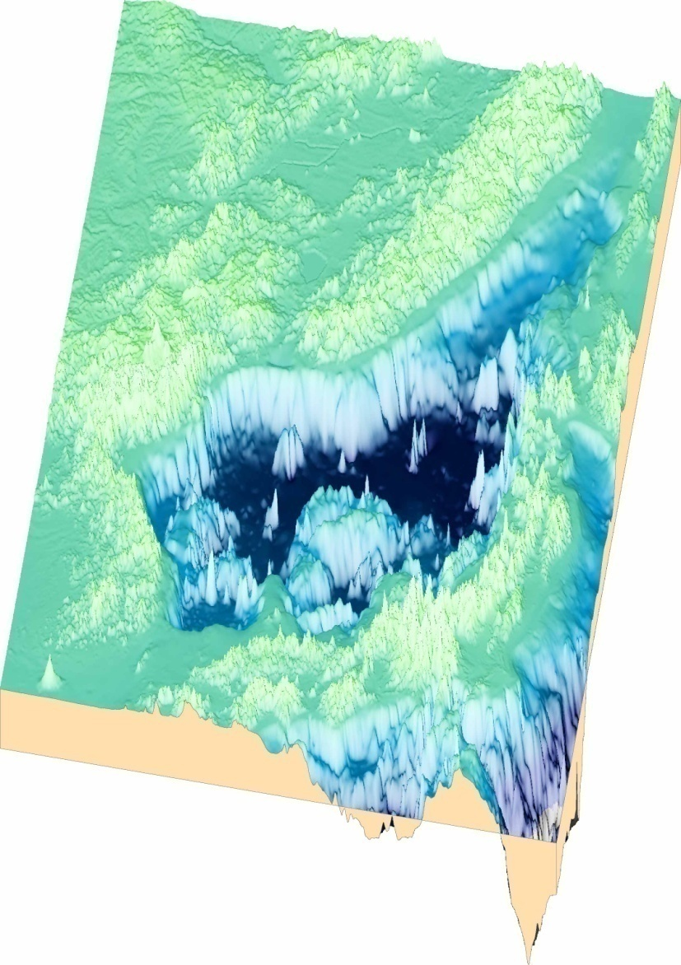
OceanSITES meeting December 1, 2011, SIO, La Jolla
Deep Ocean Monitoring :
the East Sea (Sea of Japan)
Kuh Kim¹, Kyung-Il Chang¹, Yun-Bae Kim²
Jae-Hak Lee³, Sang-Chul Hwang³
¹Seoul National University
²Pohang University of Science and Technology
³Korea Ocean Research and Development Institute

Slide 2
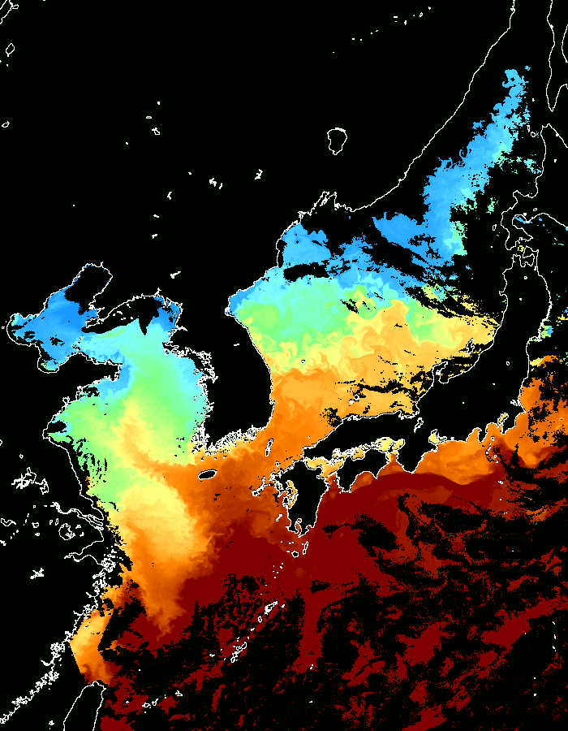
Upper Circulation & Topography
Kuroshio
Kuroshio branches: Tsushima Current
Tartar Strait
Depth (m)
Soya Strait
Area ~10⁶ km²
Average depth : ~ 1,700 m
Max. depth : ~ 4,000 m
3 deep basins (> 2000m)
4 shallow straits (< 200m)
Japan Basin
Tsugaru
Strait
Yamato Basin
Ulleung Basin
Korea Strait

Slide 3
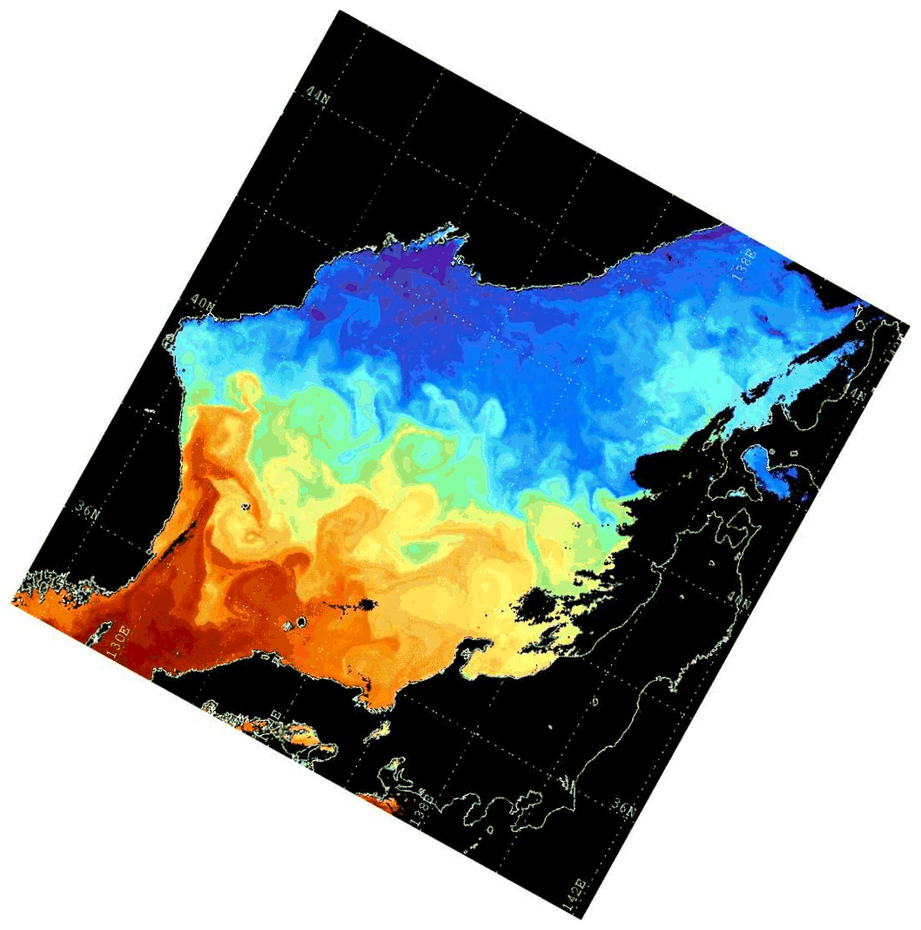
Oceanographic Characteristics
Cold Region
0
Warm Region
Warm and cold water regions across a subpolar front
Deep water formation in winter & thermohaline circulation
Boundary currents, multiple spatio-temporal variation
Depth (m)
500
1000
1500
2000
2500
3000
P.T
S
3500
The East/Japan Sea : a semi-closed marginal sea
“a miniature ocean”.

Slide 4
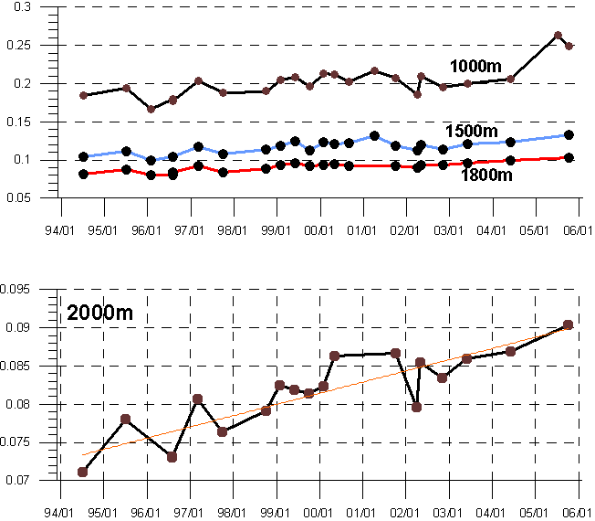
The East Sea in Change
Variation of potential temperature
in the Ulleung Basin
UB: Ulleung Basin
WJB: Western Japan Basin
NP: North Pacific
Region | Warming at 2000m | Warming rate
UB | 0.017 ºC (1994~2005) | 0.0017 ºC/year
WJB | 0.012 ºC (1994~2005) | 0.0012 ºC/year
NP | < 0.01 ºC (1985-1999) | < 0.0007 ºC/year
Unusal warming rate over global average

Slide 5
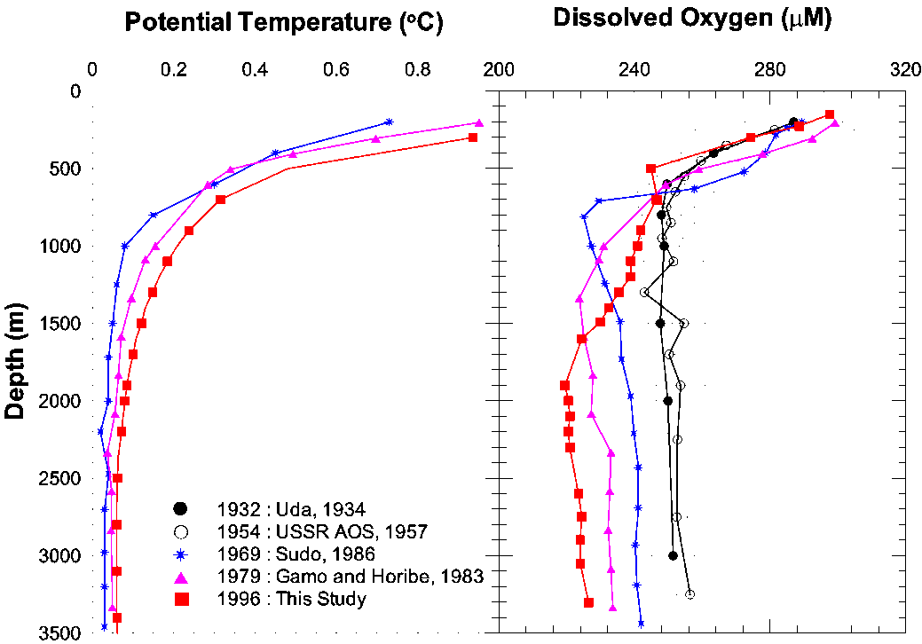
The East Sea in Change
Warming &
Declining of dissolved
oxygen contents
in deep water
Kim et al., 2001
Changes in ventilation system
Kang et al., 2003

Slide 6
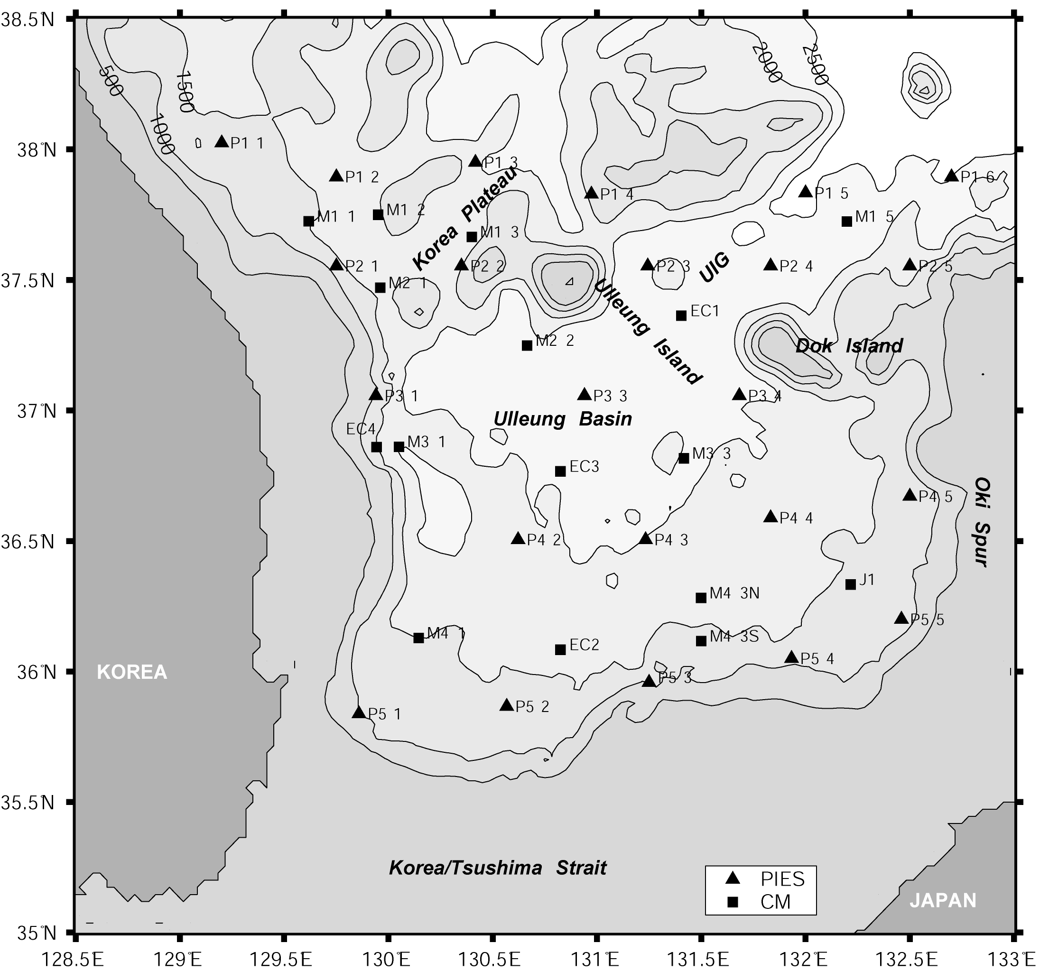
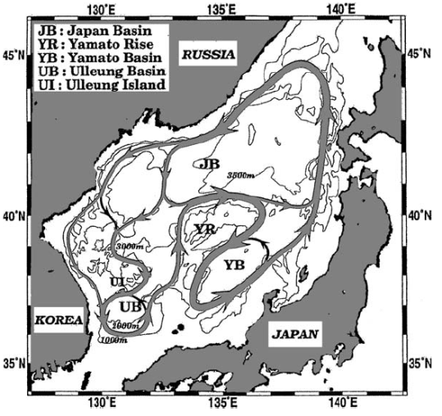
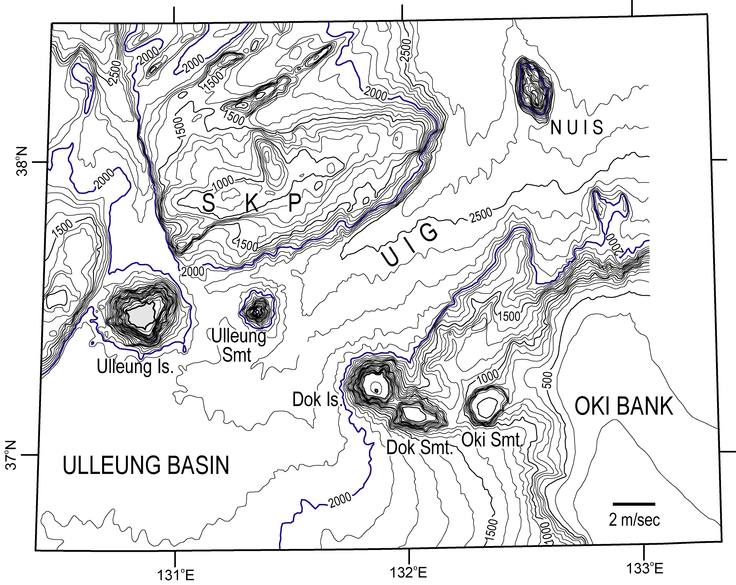
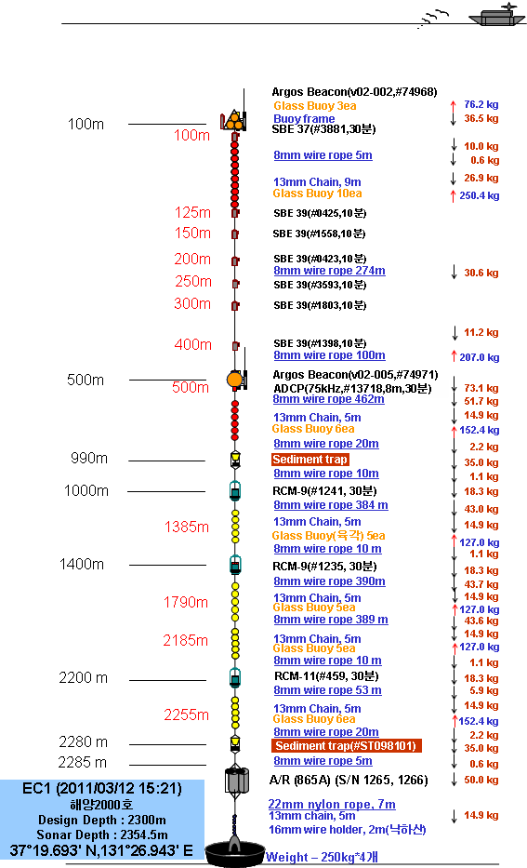
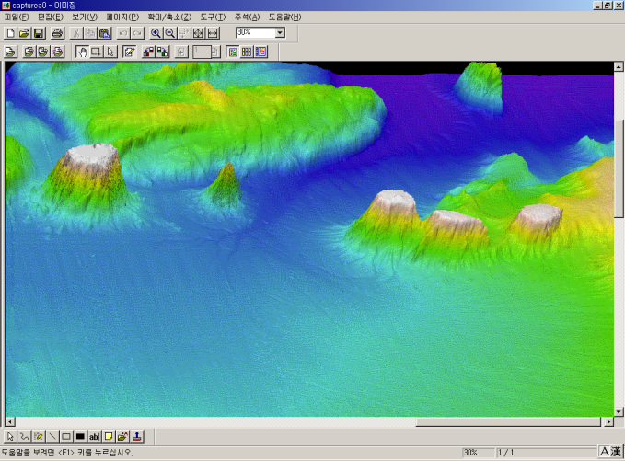
Long-term current monitoring at EC1
Ulleung Interplain Gap (UIG): Unique passage way
for deep water exchange below 1500 m between the
Japan Basin and the Ulleung Basin (Choke point)
~2500 m deep, ~75 km wide, ~100 km long
Site description: EC1
Period: 1996~present
Total depth: ~ 2200 m
Mooring type: subsurface mooring
Nominal depths: ~400,1500,2000m
Mooring turn-around: ~ 1 year
Current meters: RCM-type
Additional sensors: CTDs
Upper current measurements since 2001
With ADCP(300kHz) at ~200 m
2001/10~2002/05
2002/11~2004/04
2008/11~2010/02
With ADCP(75kHz) at 500 m
2010/02~present
Schematic abyssal circulation
(Senjyu et al., 2005)
Feb. 2011 ~ Present
EC1
Ulleungdo Is.
Dokdo Is.

Slide 7
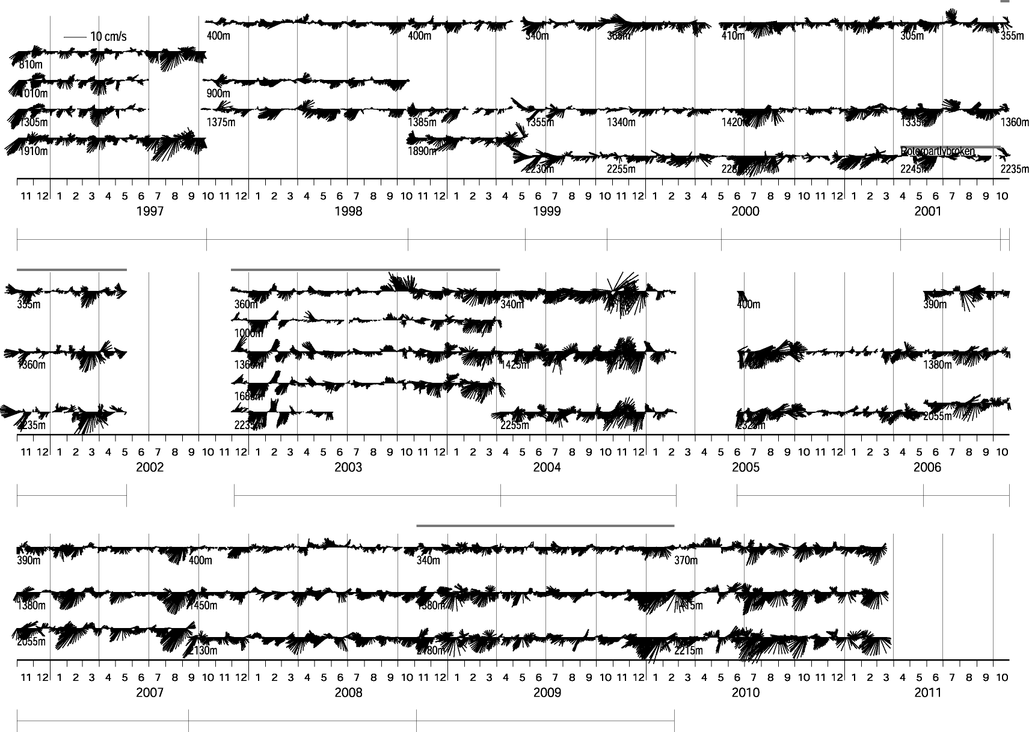
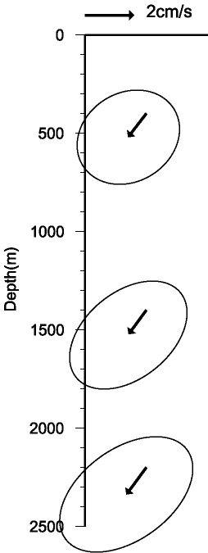
Long-term current monitoring at EC1
Southwestward mean current
Barotropic fluctuations
Bottom-intensified current
Interannual variability
UIG
1996 | 1997 | 1998 | 1999 | 2000 | 2001 | 2002 | 2003 | 2004 | 2005 | 2006 | 2007 | 2008 | 2009 | 2010 | 2011

Slide 8
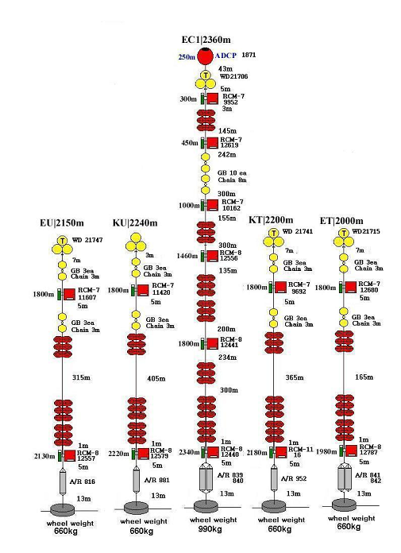
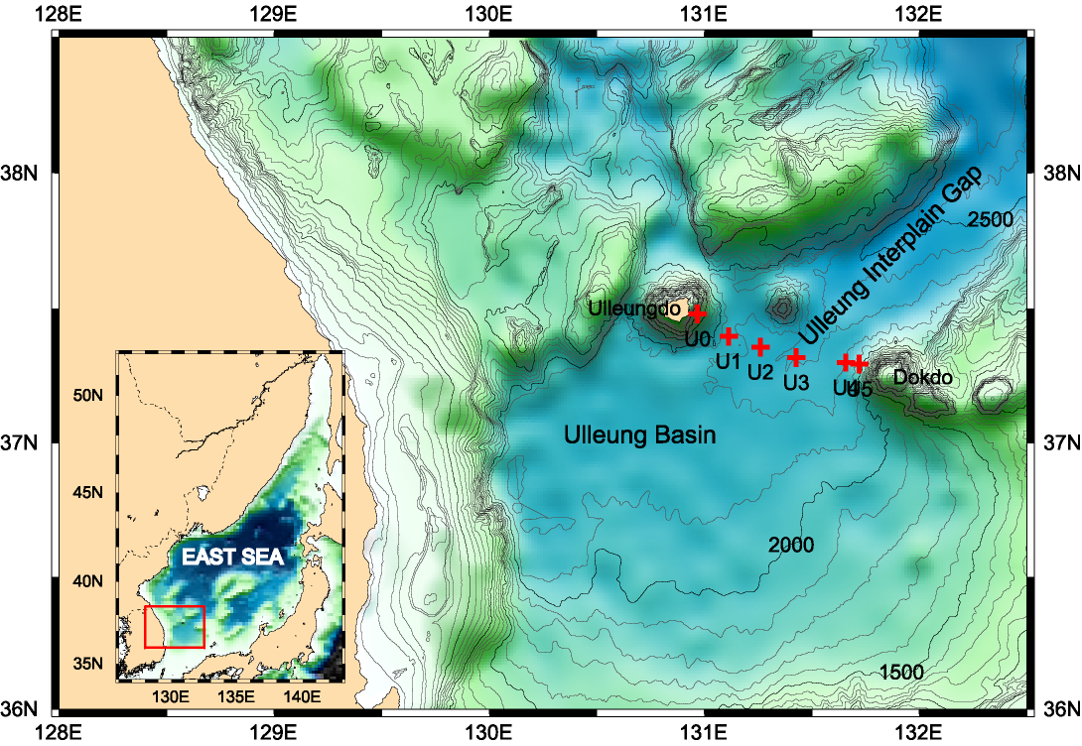
Deep Current Measurement in the UIG
U3 = EC1
Nov. November 2002~April 2004
1996 | 1997 | 1998 | 1999 | 2000 | 2001 | 2002 | 2003 | 2004 | 2005 | 2006 | 2007

Slide 9
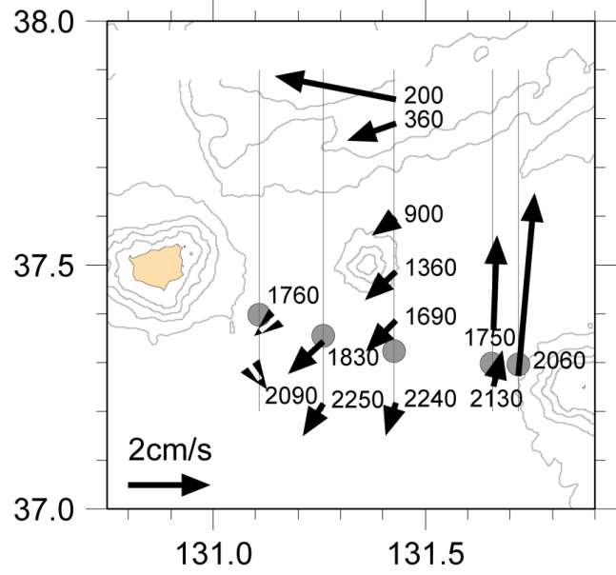
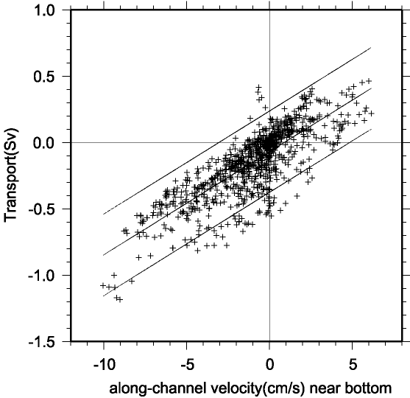
Deep Current Measurement in the UIG
Record-length mean currents
Bottom currents at EC1 vs.
total deep water transport below 1800 m
EC1
Chang et al. (2009)
Deployment of an array of 5 moorings for ~16 months
Two-way circulation:
weak & broad inflow vs. strong & narrow outflow (Dokdo Abyssal Current)
Strong inflow takes place at EC1.
A single point current measurement can be used for indexing the inflow deep water transport.
Mean net transport below 1800 m ~ 0 Sv
Mean inflow transport below 1800 m ~0.16 Sv

Slide 10
Marginal Sea OceanSITES site
EC1 in November 1996 : a joint SNU-KORDI-WHOI mooring
Financial Support:
1996~2005 : KORDI’s in-house projects
2006~2015 : SNU’s EAST-I
SNU & other Korean institutions will sustain this mooring.
We wish to enroll EC1 as a marginal sea OceanSITES site.
Data sharing will be free and open, available within 12 months
of instrument recovery.
1996 | 1997 | 1998 | 1999 | 2000 | 2001 | 2002 | 2003 | 2004 | 2005 | 2006 | 2007 | 2008 | 2009 | 2010 | 2011
Contact: Prof. Kyung-Il Chang (kichang@snu.ac.kr), Seoul National University

Slide 11
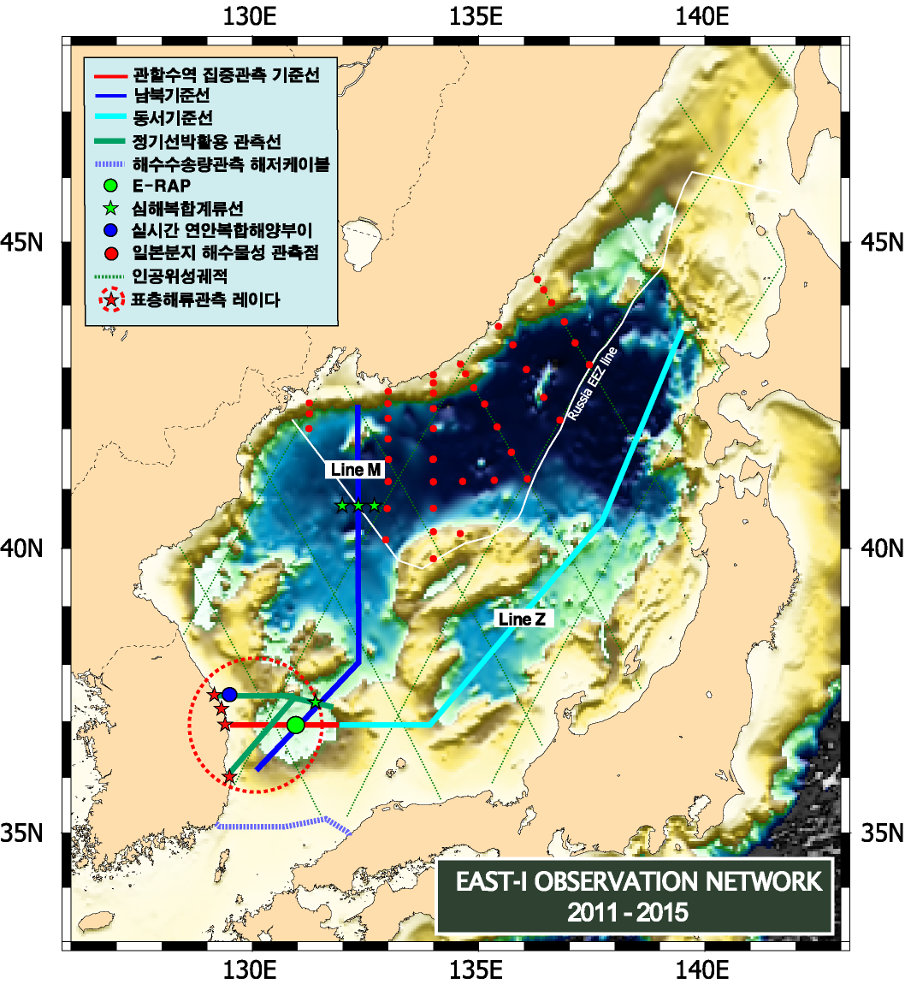
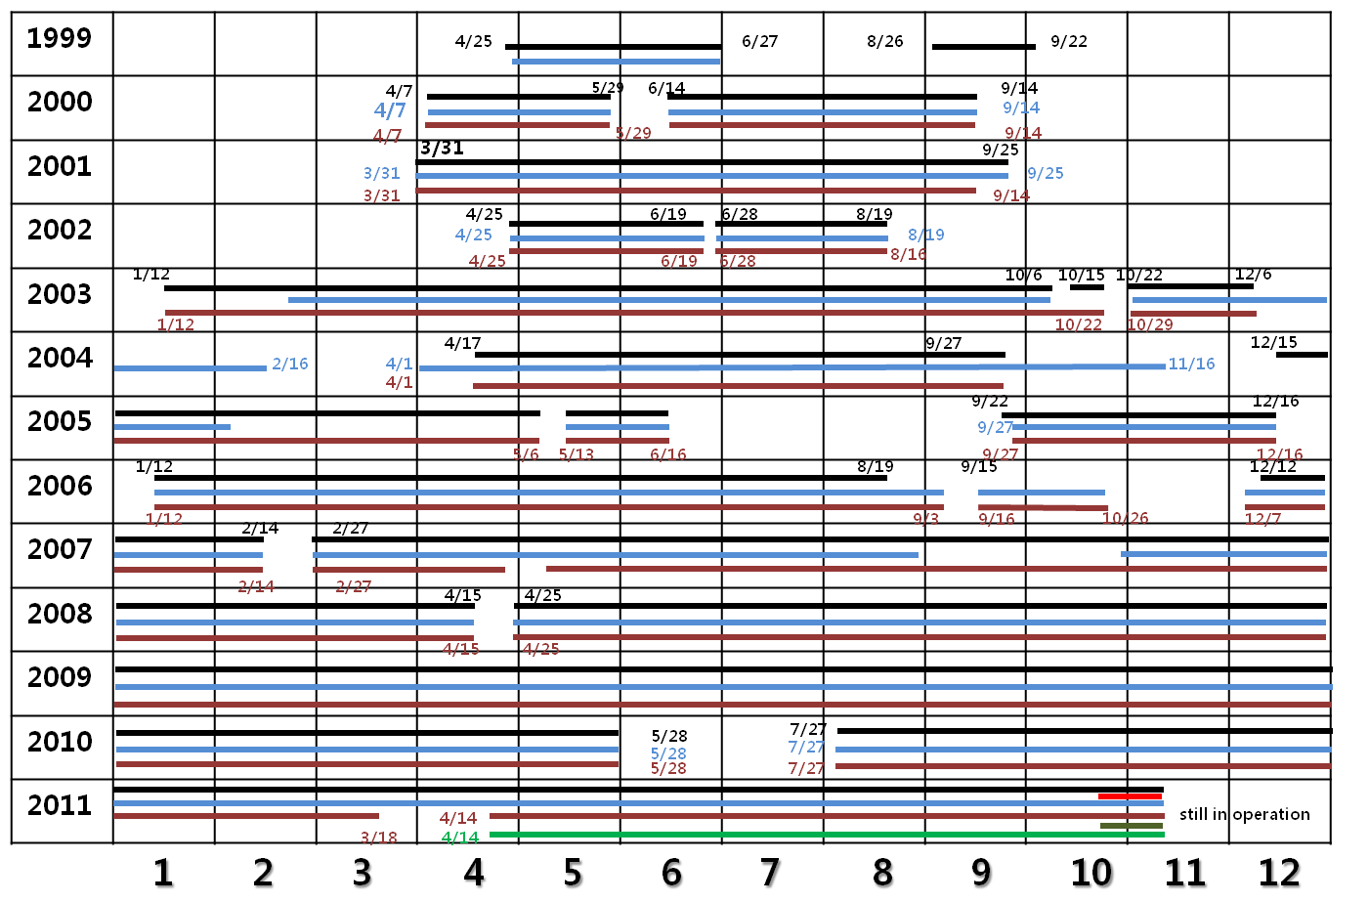
Associated Time-series Stations
Repeated hydrography since 1993
Submarine cable voltage measurement since 1998
EC1 since 1996
HF radar stations since 2010
Moored profiler (SuperStation) since 2010
Coastal ocean buoy (ESROB) since 1999:
Met. sensors, bio-optical sensors, ADCP, CTDs
ADCP, Met. CTD WQM PIR/PSP Fluorometer

