Slide 1
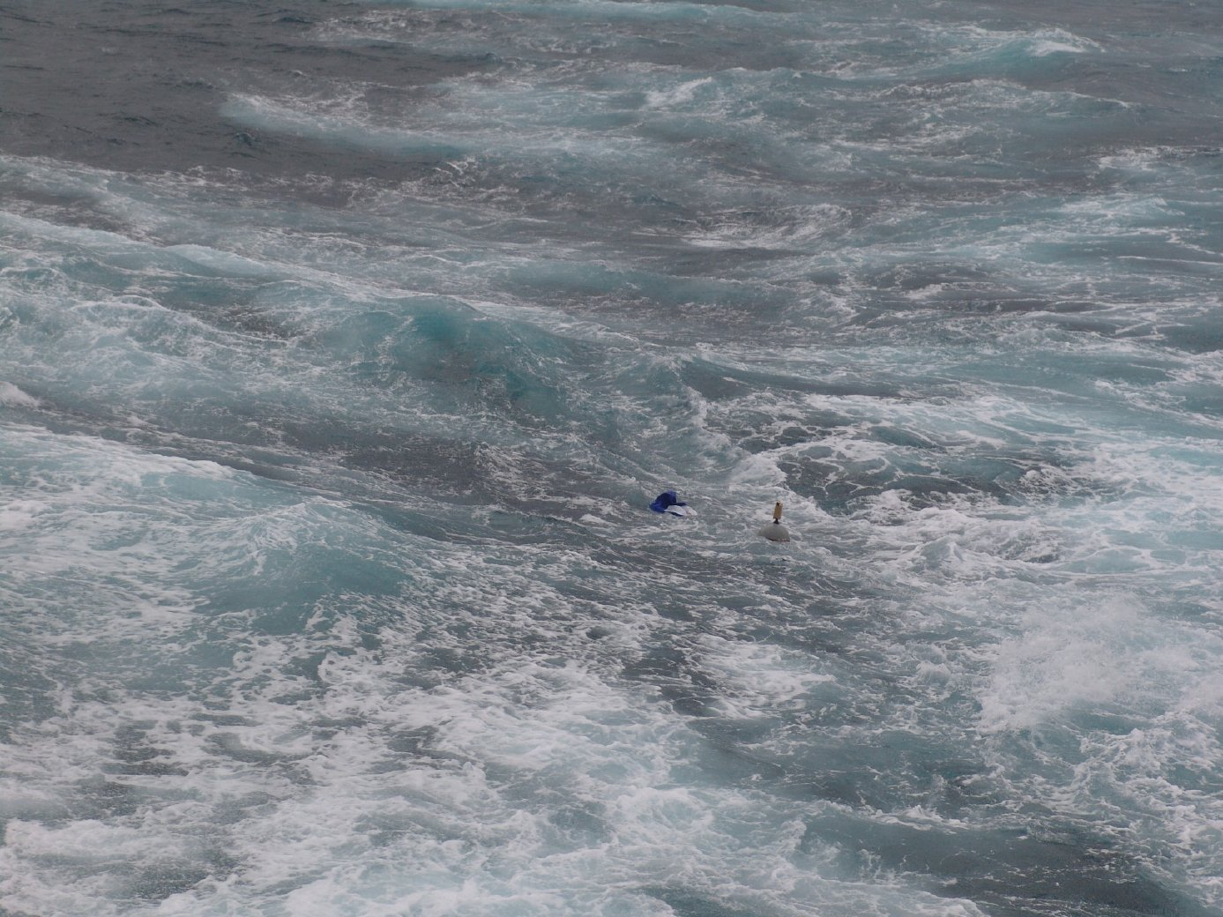

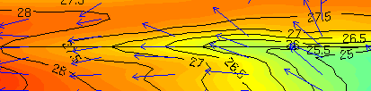
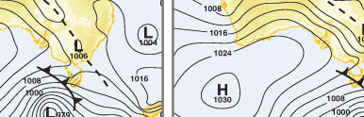
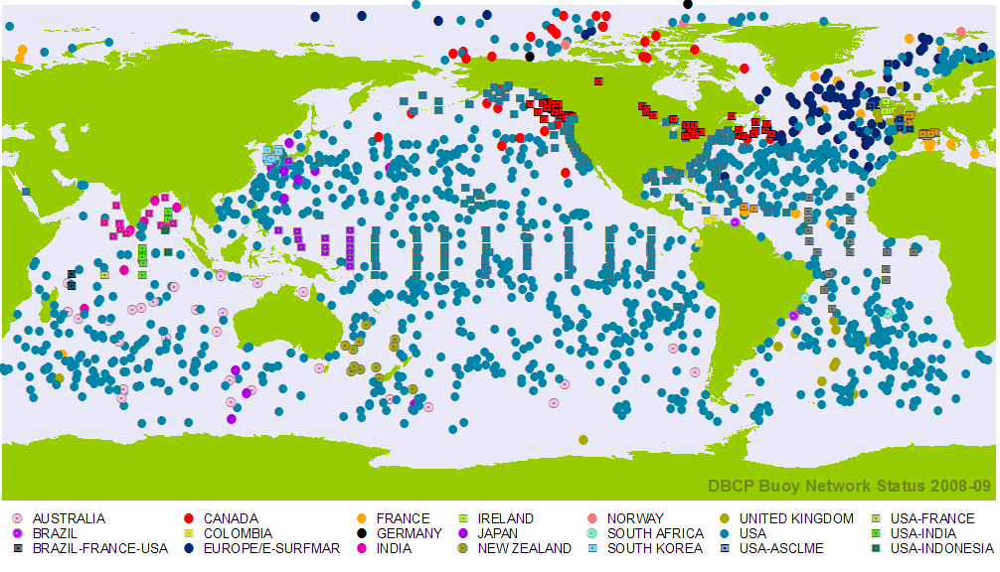
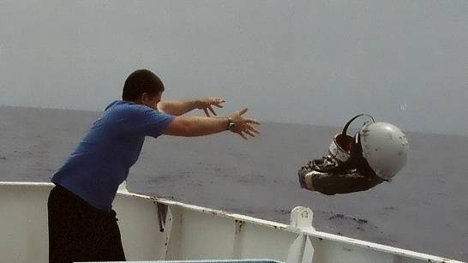
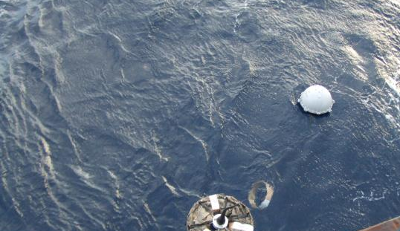
DATA BUOY
COOPERATION PANEL
» Increasing the quantity, quality and timeliness of atmospheric and oceanographic data in ocean areas where few other measurements are taken.
IMPROVING GLOBAL FORECASTS OF WEATHER & OCEAN CONDITIONS
» Data buoys measure air pressure, temperature (sea-surface & air), ocean current velocity and wind velocity across all oceans. These observations are relayed by satellite and used immediately to improve forecasts and increase marine safety.
SHIPS AHOY!
» Most drifting buoys are deployed by commercial ships and research vessels. Without such cooperation the global buoy network of over 1250 drifting buoys and 400 moored buoys could not exist today and would be hard to sustain in future.
DBCP Buoy Network Status 2008
HOW CAN MARINERS HELP?
» The DBCP is looking for ships to be part of this global effort. We have an ongoing need to deploy buoys in order to maintain the network. Buoys are pre-packaged for easy deployment, from the lowest deck or ramp, whilst underway.
Contact: support@jcommops.org
http://www.jcommops.org/dbcp

Slide 2
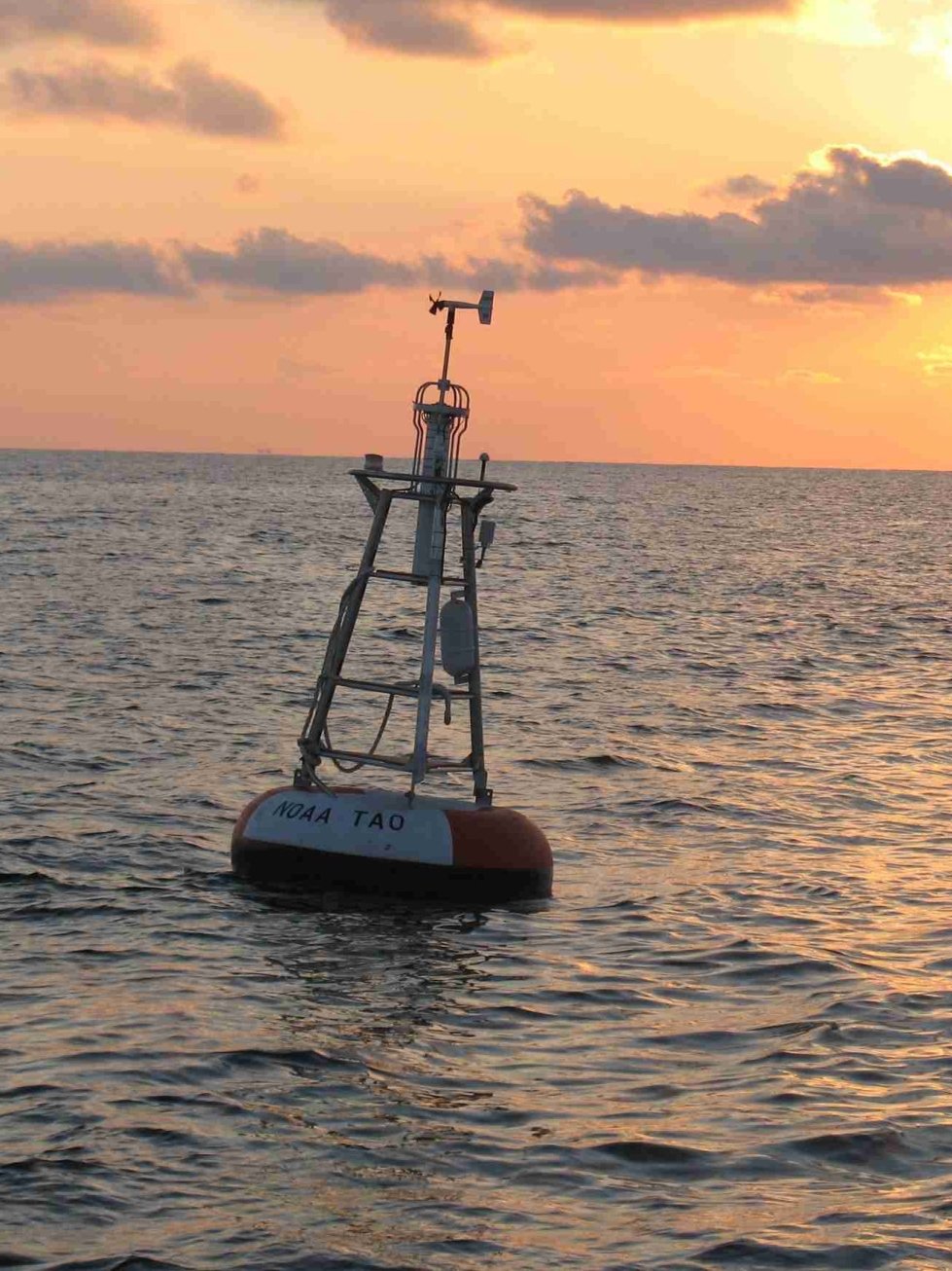
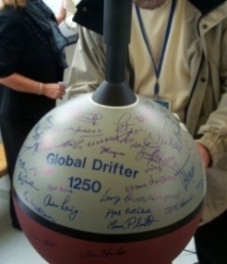
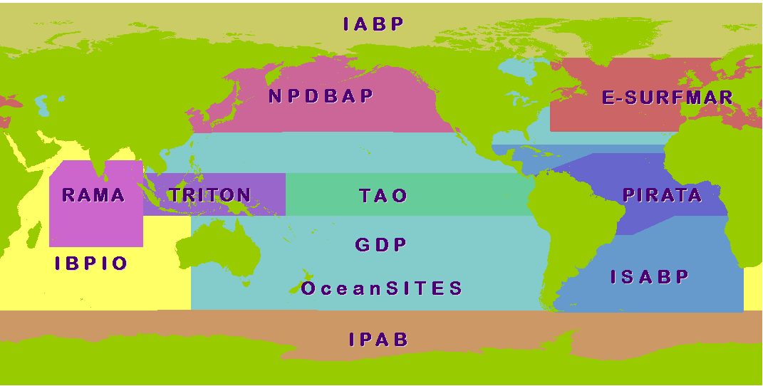
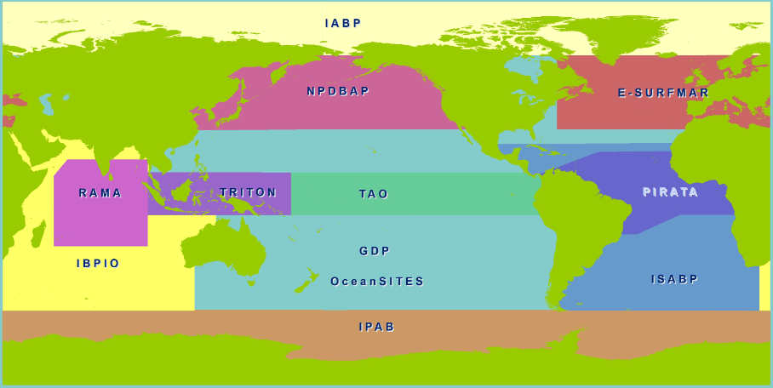
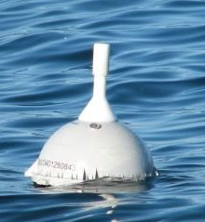
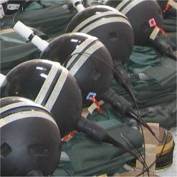


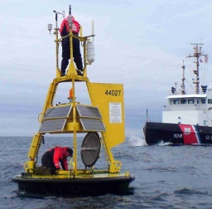

The DBCP is an international program coordinating the use of autonomous
data buoys to observe the atmosphere and ocean for forecasting and research.
WHERE THE ACTION IS
Much of the work achieved by the DBCP is through Action Groups. Each group maintains an observational buoy program that supplies data for operational and research purposes.
The DBCP has the following action groups:
The DBCP was formed in 1985, as a joint body of the World Meteorological Organization (WMO) and Intergovernmental Oceanographic Commission (IOC) of UNESCO. It makes up the data buoy component of the Joint WMO-IOC Technical Commission for Oceanography and Marine Meteorology (JCOMM) .
Global
» The Global Drifter Program (GDP)
» OceanSITES (long-term, deepwater reference stations)
» Tropical Moored Buoy Implementation Panel
(TAO, TRITON, PIRATA, RAMA)
Regional
» European EUCOS Surface Marine Programme (E-SURFMAR )
» International Arctic Buoy Programme (IABP)
» International South Atlantic Buoy Programme (ISABP)
» North Pacific Data Buoy Advisory Panel (NPDBAP)
» International Buoy Program for the Indian Ocean (IBPIO)
» International Programme for Antarctic Buoys (IPAB)
http://www.jcommops.org/dbcp/dbcp_ag.html
Global Drifter 1250
The DBCP was the first component of the Global Ocean Observing system (GOOS) to achieve its initial goal, when in 2005, it deployed its 1250th drifter, meaning at least one buoy in every 500 x 500 km square.
DBCP Action Group Map
DATA BUOYS
» Data Buoys, whether drifting or
moored, measure and transmit
automatically, in a predictable and
controlled way, communicating in
real time via satellite systems such
as Argos and Iridium. Data buoy
observations make significant
contributions to our ability to model,
understand and describe global weather and climate on all time and space scales. The data collected complements or validates data from other platforms (such as from Voluntary Observing Ships) and remotely- sensed data.
A Drifting Buoy at sea
GET INVOLVED
Credits: Produced by JCOMMOPS 2009. Photos by NOAA USA (AOML, NDBC & PMEL), Metservice NZ, Bureau of Meteorology (Aust.) , SAMS (Scotland) and JCOMM.
» Membership
All IOC and WMO member states are invited to participate in the DBCP. Panel membership is also open to any other interested parties, such as buoy manufacturers, data users, researchers and ship operators.
» Contact
Ms Champika Gallage
DBCP Technical Coordinator
JCOMMOPS
8-10 Rue Hermes
Parc Technologique du Canal
Ramonville Saint Agne 31520
FRANCE
Tel: +33 2 29 00 85 88
Email: support@jcommops.org
) Drifting Buoys, generally attached to some form of drogue or sea-anchor, are easy to deploy and reliably measure the atmosphere and ocean surface conditions for an average of 18 months. They track ocean currents at the depth corresponding to the length of their drogue and are relatively inexpensive to operate. The DBCP has been working for decades to design standardised drifting buoys to suit observational requirements for meteorological and oceanographic applications.
B Moored Buoys are anchored at fixed locations and regularly collect observations from many different atmospheric and oceanographic
sensors. Moored buoys are usually
deployed to serve national
forecasting needs, maritime safety
needs or to observe regional
climate patterns. They are generally
upgraded or serviced yearly.
www.wmo.int
www.ioc-unesco.org
www.jcommops.org
Drifting Buoys during manufacture
A Moored Buoy being serviced
www.jcommops.org/dbcp

